Slide 1
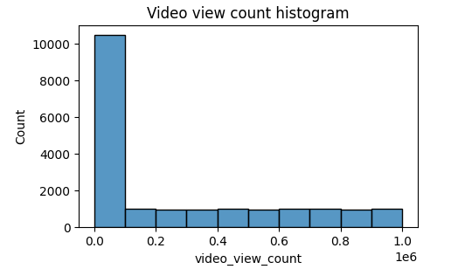
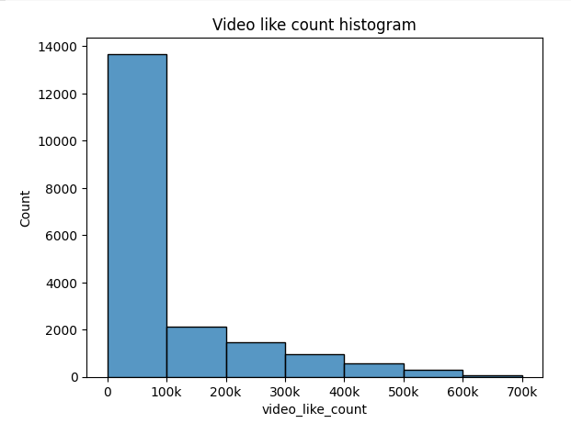
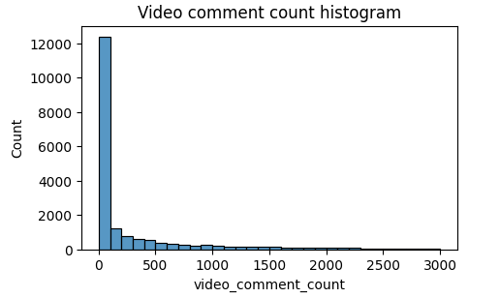
TikTok Claims Classification Project
Exploratory Data Analysis - Executive Summary
A key component of this project’s exploratory data analysis includes visualizing the data. As showcased in the following histograms, it is clear that the vast majority of videos are grouped at the bottom of the range of values for three variables that showcase TikTok users (video viewers’) engagement with the videos included in the dataset.
The TikTok data team is determined to develop a machine learning model that is able to assist in the classification of claims for user submission. Prior to any model being built, the data must be studied, analyzed, cleaned, and structured first.
The TikTok data team conducted exploratory data analysis during this time. The purpose of the analysis step is to understand the impact that TikTok videos have on its users. To better understand this impact, the data team analyzed variables that highlighted user engagement, such as view, like, and comment counts.
The view count variable has a very uneven distribution, with over half the videos receiving fewer than 100,000 views. Distribution of view counts greater than 100,000 views is uniform.
Based on the findings from the exploratory data analysis, the future claim classification model must account for null values and imbalance in opinion video counts by incorporating them into the model parameters.
The overwhelming majority of videos are grouped at the bottom of the range of values for video comment count. Most videos have fewer than 100 comments. The distribution of the view comment count is very right-skewed.
The exploratory data analysis completed by TikTok’s data team revealed many considerations for the classification model. These included missing values, “claims” to “opinions” balance, and overall distribution of data variables. There were two key insights from this analysis, which included:
Null values
Over 200 null values were found in 7 different columns. Because of this,, future modeling should consider the null values to avoid making insights that would assume complete data. Further analysis is needs to be done to investigate the reason for the null values, and their impact on future statistical analysis or model building.
Skewed data distribution
Video view and like counts are all concentrated on lower end of 1,000 for opinions. The data distribution is right-skewed, which will inform the models and model types that will be constructed.

